Slide 1
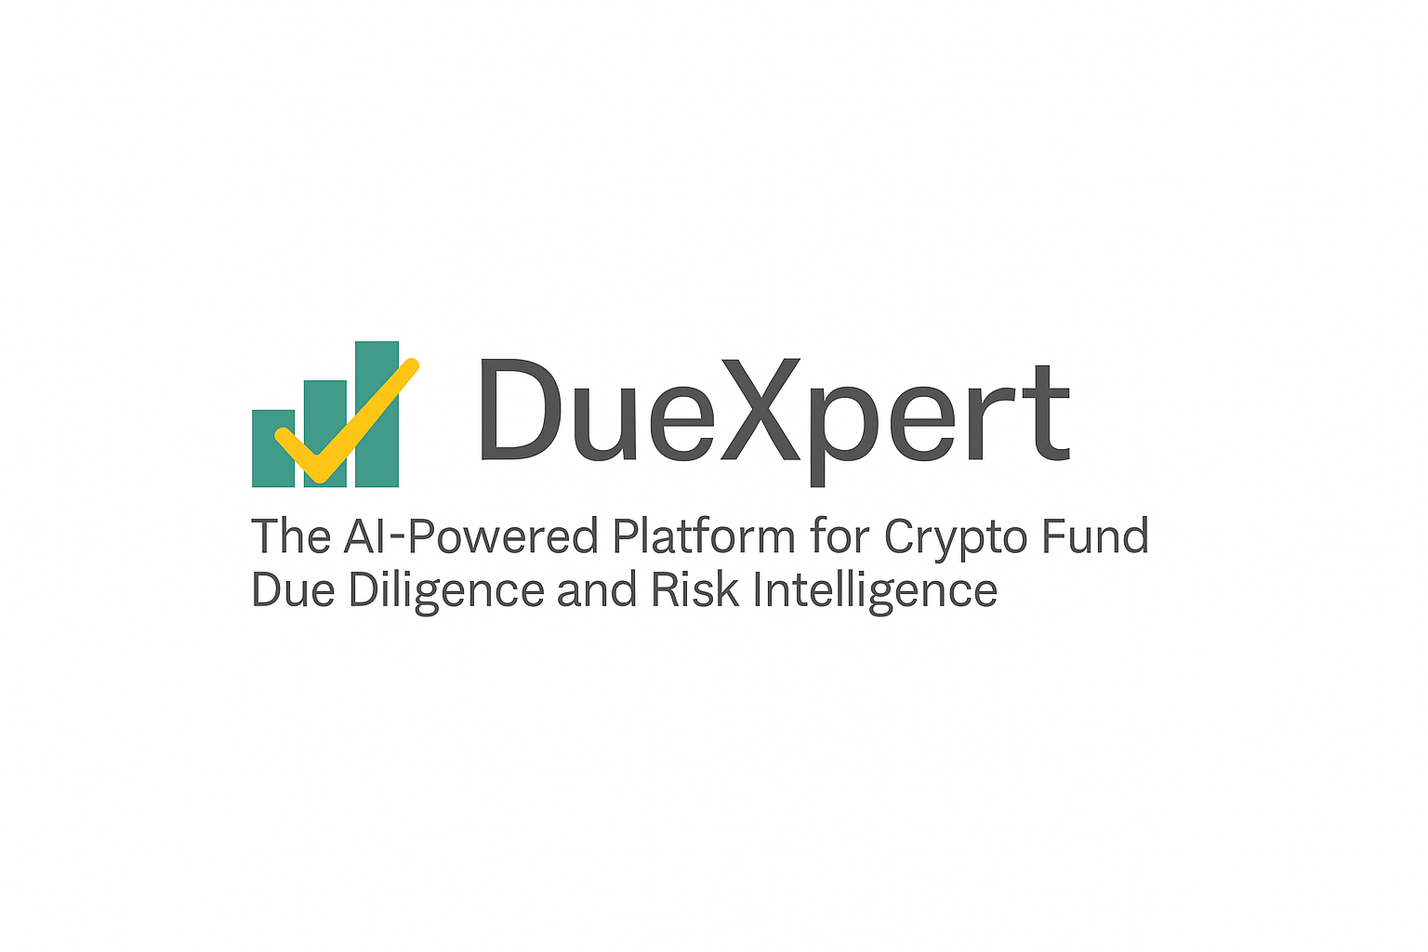
the CryptoBazar Due Diligence Analytics
Prepared by DueXpert AI | 2025-04-26
DueXpert – AI Crypto Fund Due Diligence Suite | General

Slide 2
Table of Contents
2. AML / KYC Analytics
3. Community & UX Analytics
4. Custody & Asset Security Analytics
5. Cybersecurity & Data Privacy Analytics
6. ESG & Sustainability Analytics
7. Financial Health Analytics
8. Future Outlook Analytics
9. Governance Analytics
10. IP & Contracts Analytics
11. Legal & Regulatory Analytics
12. Risk Management Analytics
13. Strategy & Competitive Positioning Analytics
16. Summary Analytics Analytics
14. Technology & Infrastructure Analytics
15. Tokenomics & Trading Integrity Analytics
DueXpert – AI Crypto Fund Due Diligence Suite | Table of Contents

Slide 3
2. AML / KYC Analytics
Objective: Ensure robust Anti-Money Laundering and Know Your Customer compliance.
Completeness: 16.7%
Risk Score: 100.0/100
Found Criteria:
• know your customer
• anti-money laundering
Missing Criteria:
• AML policies
• KYC procedures
• compliance measures
• regulatory adherence
• transaction monitoring
• sanctions screening
• client verification
• due diligence checks
• risk-based approach
• compliance program
Importance Weight: 1.000
DueXpert – AI Crypto Fund Due Diligence Suite | AML / KYC Analytics
Page 2

Slide 4
3. Community & UX Analytics
Objective: Assess user engagement, usability, and community transparency.
Completeness: 16.7%
Risk Score: 14.4/100
Found Criteria:
• user engagement
• community transparency
Missing Criteria:
• platform usability
• feedback mechanisms
• user experience
• interface design
• community governance
• social media presence
• user support
• accessibility
• stakeholder interaction
• transparency reports
Importance Weight: 0.144
DueXpert – AI Crypto Fund Due Diligence Suite | Community & UX Analytics
Page 3

Slide 5
4. Custody & Asset Security Analytics
Objective: Evaluate asset storage and custody security mechanisms.
Completeness: 25.0%
Risk Score: 72.0/100
Found Criteria:
• insurance coverage
• multi-signature wallets
• asset storage
Missing Criteria:
• asset ownership verification
• cold storage
• hot wallets
• custodial services
• security protocols
• asset protection
• private key management
• audit trails
• fund safeguarding
Importance Weight: 0.800
DueXpert – AI Crypto Fund Due Diligence Suite | Custody & Asset Security Analytics
Page 4

Slide 6
5. Cybersecurity & Data Privacy Analytics
Objective: Examine cybersecurity and data protection practices.
Completeness: 0.0%
Risk Score: 96.0/100
Found Criteria:
• None
Missing Criteria:
• blockchain technology
• cybersecurity measures
• two-factor authentication
• data protection policy
• encryption standards
• network security
• data privacy compliance
• penetration testing
• firewall protection
• GDPR compliance
• security audits
• threat detection
Importance Weight: 0.800
DueXpert – AI Crypto Fund Due Diligence Suite | Cybersecurity & Data Privacy Analytics
Page 5

Slide 7
6. ESG & Sustainability Analytics
Objective: Evaluate environmental, social, and governance sustainability.
Completeness: 8.3%
Risk Score: 10.6/100
Found Criteria:
• environmental impact
Missing Criteria:
• sustainability practices
• energy consumption
• sustainability audits
• carbon footprint
• green initiatives
• social responsibility
• governance standards
• ethical investing
• renewable energy
• ESG reporting
• community impact
Importance Weight: 0.096
DueXpert – AI Crypto Fund Due Diligence Suite | ESG & Sustainability Analytics
Page 6

Slide 8
7. Financial Health Analytics
Objective: Analyze financial statements and health indicators.
Completeness: 16.7%
Risk Score: 51.2/100
Found Criteria:
• annual auditing
• financial statements
Missing Criteria:
• cash flow projections
• tax disputes
• balance sheet
• profit and loss
• liquidity ratios
• debt obligations
• revenue streams
• expense management
• financial audits
• capital reserves
Importance Weight: 0.512
DueXpert – AI Crypto Fund Due Diligence Suite | Financial Health Analytics
Page 7

Slide 9
8. Future Outlook Analytics
Objective: Evaluate alignment with 2025 crypto trends and innovations.
Completeness: 0.0%
Risk Score: 7.7/100
Found Criteria:
• None
Missing Criteria:
• stablecoin compliance
• AI integration
• institutional adoption
• quantum resistance
• market trends
• technological innovation
• regulatory evolution
• growth projections
• digital asset trends
• blockchain adoption
• strategic foresight
• innovation pipeline
Importance Weight: 0.064
DueXpert – AI Crypto Fund Due Diligence Suite | Future Outlook Analytics
Page 8

Slide 10
9. Governance Analytics
Objective: Assess decision-making and board oversight structures.
Completeness: 8.3%
Risk Score: 42.2/100
Found Criteria:
• board of directors
Missing Criteria:
• conflict of interest policies
• external audits
• succession planning
• governance framework
• decision-making process
• transparency measures
• executive oversight
• stakeholder rights
• policy enforcement
• ethical standards
• board independence
Importance Weight: 0.384
DueXpert – AI Crypto Fund Due Diligence Suite | Governance Analytics
Page 9

Slide 11
10. IP & Contracts Analytics
Objective: Evaluate intellectual property and contract integrity.
Completeness: 0.0%
Risk Score: 11.5/100
Found Criteria:
• None
Missing Criteria:
• intellectual property assets
• IP infringement
• smart contract audits
• major contracts
• patent protection
• trademark registration
• contract compliance
• legal agreements
• code licensing
• proprietary technology
• IP portfolio
• contractual obligations
Importance Weight: 0.096
DueXpert – AI Crypto Fund Due Diligence Suite | IP & Contracts Analytics
Page 10

Slide 12
11. Legal & Regulatory Analytics
Objective: Ensure legal and regulatory compliance.
Completeness: 0.0%
Risk Score: 100.0/100
Found Criteria:
• None
Missing Criteria:
• licenses and permits
• international law compliance
• sanctions monitoring
• regulatory filings
• legal compliance
• regulatory framework
• compliance audits
• jurisdictional adherence
• securities law
• tax compliance
• legal disputes
• regulatory reporting
Importance Weight: 1.000
DueXpert – AI Crypto Fund Due Diligence Suite | Legal & Regulatory Analytics
Page 11

Slide 13
12. Risk Management Analytics
Objective: Identify risk management strategies.
Completeness: 8.3%
Risk Score: 42.2/100
Found Criteria:
• risk management strategies
Missing Criteria:
• market volatility
• business continuity plan
• operational resilience
• risk assessment
• mitigation plans
• crisis management
• risk exposure
• contingency planning
• market risk
• operational risk
• compliance risk
Importance Weight: 0.384
DueXpert – AI Crypto Fund Due Diligence Suite | Risk Management Analytics
Page 12

Slide 14
13. Strategy & Competitive Positioning Analytics
Objective: Understand strategy and market positioning.
Completeness: 8.3%
Risk Score: 10.6/100
Found Criteria:
• market positioning
Missing Criteria:
• competitor analysis
• investment strategies
• growth strategies
• market share
• competitive advantage
• strategic planning
• business development
• market trends
• innovation strategy
• partnerships
• go-to-market strategy
Importance Weight: 0.096
DueXpert – AI Crypto Fund Due Diligence Suite | Strategy & Competitive Positioning Analytics
Page 13

Slide 15
14. Technology & Infrastructure Analytics
Objective: Evaluate technological scalability and reliability.
Completeness: 8.3%
Risk Score: 15.8/100
Found Criteria:
• security measures
Missing Criteria:
• scalability plans
• blockchain technology
• infrastructure upgrades
• system architecture
• network reliability
• tech stack
• performance metrics
• cloud infrastructure
• protocol security
• system redundancy
• tech audits
Importance Weight: 0.144
DueXpert – AI Crypto Fund Due Diligence Suite | Technology & Infrastructure Analytics
Page 14

Slide 16
15. Tokenomics & Trading Integrity Analytics
Objective: Assess token economics and trading transparency.
Completeness: 33.3%
Risk Score: 23.0/100
Found Criteria:
• code reviews
• token economics
• trade surveillance
• market manipulation
Missing Criteria:
• securities compliance
• valuation consistency
• token distribution
• liquidity provision
• trading policies
• exchange compliance
• price stability
• audit reports
Importance Weight: 0.288
DueXpert – AI Crypto Fund Due Diligence Suite | Tokenomics & Trading Integrity Analytics
Page 15

Slide 17
16. Summary Analytics
Summary:
- Total Topics: 14
- Fully Covered (>=80%): 0
- Partially Covered (40-80%): 0
- Not Covered (<40%): 14
- Avg Completeness: 10.7%
- Avg Risk Score: 42.7/100
- High-Risk Gaps: AML / KYC, Custody & Asset Security, Cybersecurity & Data Privacy, Legal & Regulatory
Recommendation: Critical Risk: Immediate action required on high-priority gaps.
DueXpert – AI Crypto Fund Due Diligence Suite | Summary Analytics
Page 16

